Slide 1
Laparoscopic surgery
R1ธนโชติ
อาจารย์ที่ปรึกษา อ.วิริยะ

Slide 2
Outlines
Laparoscopic surgery
Physiologic impact of laparoscopy
Intraoperative management
Complication related to surgery
Postoperative complications

Slide 3
Surgical approach and positioning
Minimally invasive surgical technique
Specialized tube inserted for surgical access
Small skin incision ~ 1 cm facilitate to insert rigid tube called Trocars
Trocars are sharp, multiport, one-way conduits used to insufflate gas and to guide various specialized surgical instruments

Slide 4
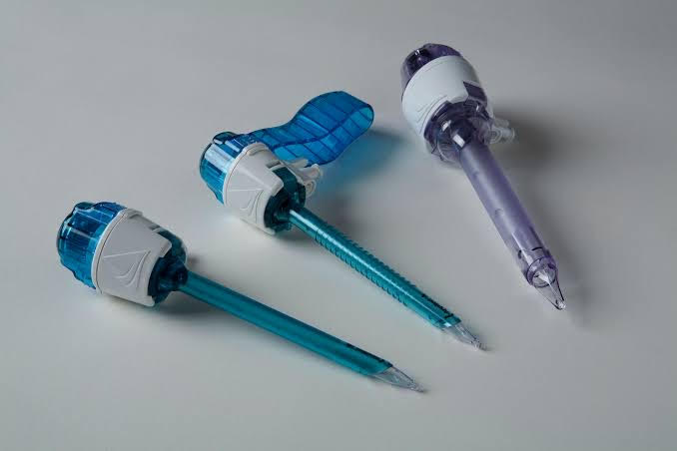

Slide 5
Surgical approach and positioning
Exposure intraperitoneal space achieved by intraperitoneal pressurization (pneumoperitoneum) or extraabdominal wall retraction called abdominal wall lift
Used CO₂ for intraperitoneal(e.g.bariatric surgery,LC) and extraperitoneal insufflation(e.g.adrenal and inguinal hernia repair surgery)
In contrast to other gas such as helium,nitrous oxide CO₂ has desirable safety profile.

Slide 6
Surgical approach and positioning
CO2 highly soluble in blood →rapid pulmonary removal, minimizing to extraperitoneal, intravascular insufflation
CO2 nonflammable, nonoxidizing→safe to use during electrocautery
Intraabdominal pressure above 15mmHg should be avoided→minimize CO2 related complication, cardiopulmonary instability

Slide 7
Patient positioning
Steep,reverse trendelenburg position(head up) →expose upper abdominal structures(gastric bypass surgery)
Steep trendelenburg position(head down)→expose lower abdominal structure(uterine or prostate surgery)
Lateral jackknife→expose retoperitoneal space (radical nephrectomy)
Leftward tilting→expose appendix
Rightward tilting→expose left colon
lithotomy→depend on need for genital, urologic access

Slide 8
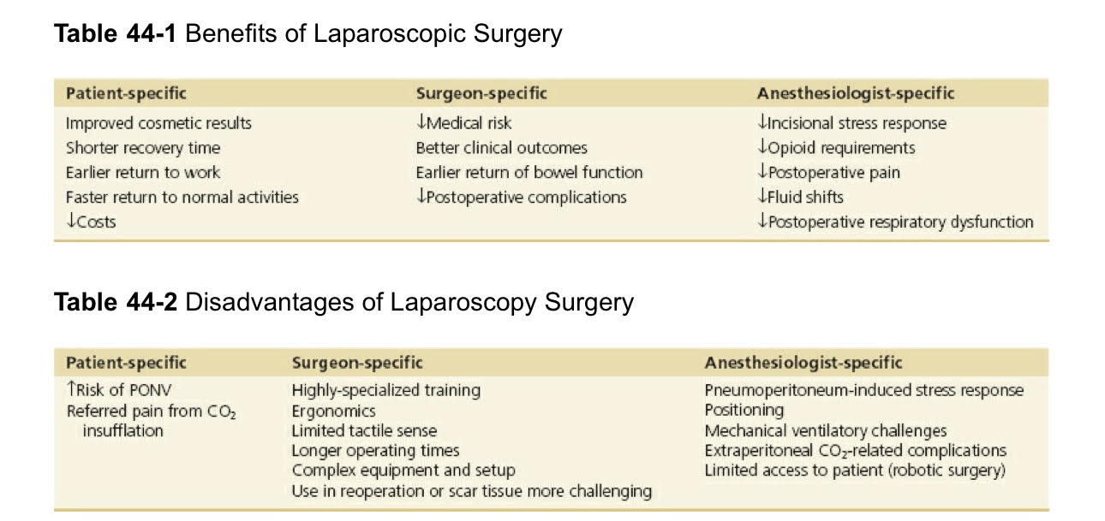

Slide 9
Physiologic Impact of Laparoscopy

Slide 10
Cardiovascular System
Multiple stressors→preload,inotropy,rhythm and afterload
↑MAP,↑myocardial O₂ demand,↑SVR
Modifiable factors: intravascular volume status, positioning, baseline comorbidities, surgical technique→affect hemodynamic

Slide 11
Cardiovascular System
Prolonged surgeries and high insufflation pressures→↑CO₂ gas absorption
Severe hypercarbia(PaCO₂ 55-70 mmHg) and acidosis→myocardial depression, dysrhythmias
hypercarbia→sympathetic nervous system stimulation→tachycardia,↑MAP, vasoconstriction(↑SVR)

Slide 12
Cardiovascular System
peritoneum and abdominal viscera highly innervated by autonomic nerve fibers
Stimulation of these autonomic pathway during laparoscopy→ SNS activation, catecolamine release, activation RAAS, release vasopressin→ vasoconstriction,↑MAP,↑LV afterload
Intravascular volume status is important modifier of mechanical effect of pneumoperitoneum.

Slide 13
Cardiovascular System
↑IAP→IVC compression→↓VR→↓cardiac filling
Patient positioning→modify effect of IAP
Trendelenburg position→↑VR,↑cardiac filling
Reverse trendelenburg→↑SVR and minor reduction CI(soon reversed)
Extremely high IAP with hypovolemia→severe compression venous system→dangerous ↓VR and cardiac filling

Slide 14
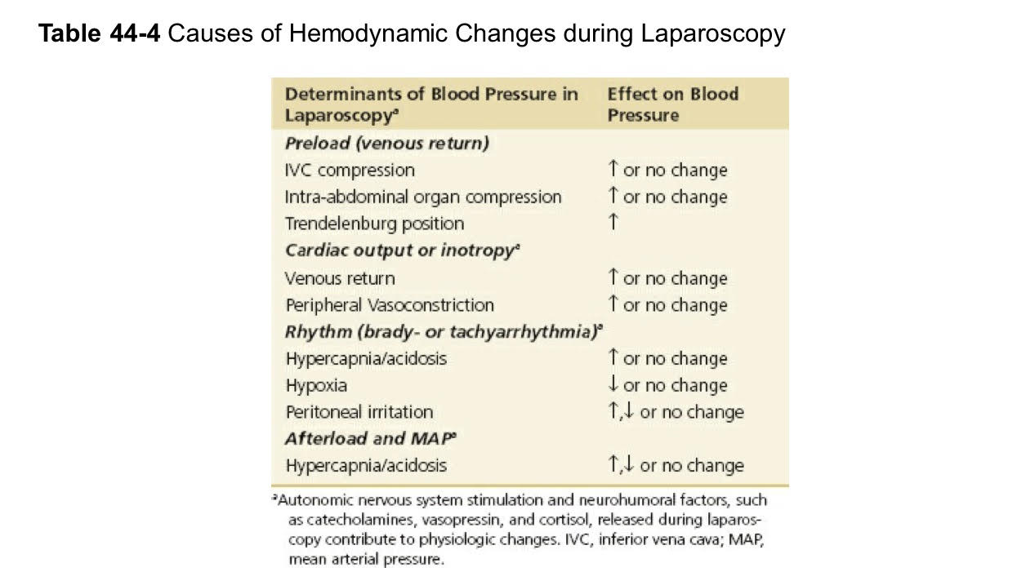

Slide 15
Respiratory System
Change by mechanically displacing thoracic structures, altering lung mechanics (i.e.,volumes,compliance,resistance) and disrupting gas exchange through ventilation-perfusion mismatch
insufflation→displace diaphragm to thorax(aggravated by trendelenburg position)→shift carina to cephalad→↑endobronchial intubation

Slide 16
Respiratory System
↑IAP and diaphramatic displacement→compression of lungs bases, atelactasis, ventilation-perfusion mismatch, hypoxemia
change pulmonary compliance observed by ↑peak inspiratory pressure(PIP) during positive pressure ventilation
Hypercarbia from CO2 pneumoperitoneum require adjustment in mechanical ventilation

Slide 17
Respiratory System
Compensatory hyperventilation→normalize hypercapnia
Prolong and steep trendelenburg position→ventilation-perfusion mismatch
Hypoxia during laparoscopy usually due to transient ventilation-perfusion mismatch(pulmonary shunting: reduce number of ventilated alveolar unit perfused)

Slide 18
Respiratory System
Morbid obesity and COPD are common pre-existing conditions may complicate ventilation and gas exchange.
Common intraoperative dilemma in morbid obesity→compensating for hypercarbia,managing inspiratory resistance,maintaining normoxia

Slide 19
Respiratory System
Trendelenburg position→significantly ↑inspiratory resistance,↓FRC, greatly impair PaO₂ (high BMI→stronger predictor)
Termination of pneumoperitoneum in morbidly obese patients→prolong return to baseline exhaled CO2 compared to healthy patients
Patients with advanced COPD→severe hypercarbia,limited correlation with standard capnography

Slide 20
Respiratory System
↓ number of intact pulmonary unit and ↓effective alveolar ventilation→ rapid and severe ↑PaCO2→refractory to hyperventilation maneuvers
EtCO2 monitoring in COPD may underestimate than actual PaCO2

Slide 21
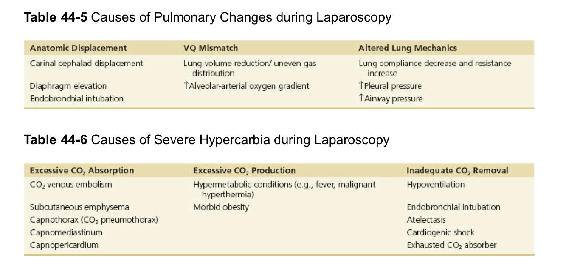

Slide 23
Regional Perfusion Effects
↓Splanchnic blood flow during laparoscopy due to external compression and systemic vasoconstriction(from released neuroendogeneous hormones)
↓mesenteric blood flow→caution in patients with GI coexisting diseases

Slide 24
Regional Perfusion Effects
↓Renal function during pneumoperitoneum
IAP, neurohormonal effects→↓renal blood flow,↓GFR,↓urine output
Prolong insufflation time at 15mmHg IAP→↓urine output without permanent renal sequelae
Vasopressin release→↓renal perfusion→renal water reabsorption in collecting duct,oliguria

Slide 25
Regional Perfusion Effects
Preop risk for renal dysfunction→↑postop AKI
In bariatric surgey ↑BMI,DM associated with AKI within 72 hours of surgery
Pneumatic compression devices during bariatric surgery→improve renal blood flow and urine output(mechanism of action unclear)

Slide 26
Regional Perfusion Effects
↑ICP and ↑cerebral perfusion during trendelenburg position and pneumoperitoneum due to diminished cerebral venous outflow and hypercarbia-induced cerebral hyperperfusion
↑cerebral O₂ delivery due to ↑cerebral perfusion pressure
↑IOP in steep trendelenburg position

Slide 28
Intraoperative Management

Slide 29
Monitoring
EKG,NIBP,capnography,pulse oximetry,body temperature→mandatory for all laparoscopic
Mechanical ventilator setting and pulmonary mechanics→modified and measure via anesthetic machhine
Invasive or advanced monitoring→pre-existing cardiopulmonary diseases

Slide 30
Anesthesia Management
Techniques :GA maintain with inhalation or TIVA
Induction with propofol→antiemetic properties
Maintenance with inhaled volatile anesthetics→standard technique
desflurane and sevoflurane with short-acting and easily titrable properties
Propofol-TIVA→recent popularity due to low incidence of PONV

Slide 31
Anesthesia Management
Nitrous oxide
Controversial
N₂O→diffuse into air spaces→adverse pressurization
N₂O→risk of PONV→avoided in some practitioners

Slide 32
Anesthesia Management
Pharmacologic Adjuncts
Use during balance anesthetic→minimize intraoperative sympathetic stimulation
Remifentanil→suppress sympatheic stimulation and neuroendocrine stress without prolong respiratory effect of longer-acting opioid

Slide 33
Anesthesia Maintenance
Neuromuscular Blockade
NMB routinely used to improve surgical exposure during pneumoperitoneum

Slide 34
Mechanical Ventilation
VCV and PCV with PEEP→ conventional mode of ventilation during GA
Extreme positioning during pneumoperitoneum create unique challenged to each mode
VC in steep trendelenburg→tidal volume constant,↑peak airway pressure,↓lung complicance
PC in steep trendelenburg→peak airway pressure constant,↓tidal volume

Slide 35
Mechanical Ventilation
Role of PEEP as cause for hypotension in laparoscopy remain controversial
High PEEP level→↑IAP→↑intrathoracic pressure→↓cardiac index
adding RM to PEEP in obese patient→improved oxygenation and lung compliance without hypotension
Caution when using compensatory ventilatory maneuvers during steep trendelenburg in obese patient because ↑peak airway pressure

Slide 36
Complications Related to Surgery

Slide 37
Intraoperative Complications
Intra-abdominal Injuries
50% complication due to abdominal entry technique
Major vascular injuries are infrequent but associated with high mortality rate
Should be prepared for immediate surgical conversion to open laparotomy to control severe bleeding while managing possible hemodynamic instability

Slide 38
Intraoperative Complications
Cardiopulmonary
Acute CVS complications →hypertension,hypotension,dysrhythmias, rarely cardiac arrest
hypertension→most common during intitial insufflation(↑IAP →↑preload and cardiac output)
Catecholamine release→aggravate hypertension by ↑afterload
hypotension sometimes result of low CO from vagal stimulation and impaired venous return during insufflation

Slide 39
Intraoperative Complications
Cardiopulmonary
Preload can be future reduced during positive pressure ventilation and steep trendelenburg position.
hypercapnia→↑PVR→impact preload in patient with pulmonary hypertension and RV failure
Tachyarrhythmia during intraperitoneal CO₂ insufflation due to catecholamine release and hypercapnia

Slide 40
Intraoperative Complications
Cardiopulmonary
Rapid peritoneal distension during insufflation→profound vasovagal reaction→acute CVS collapse and cardiac arrest
Acute hypertension→adjusting depth of anesthesia if severe case may require short-acting vasoactive agent
hypotension→decreasing depth of anesthesia, volume expansion, lower IAP insufflation, short-acting vasopressor

Slide 41
Intraoperative Complications
Cardiopulmonary
Conversion to open laparotomy or termination of surgery if recurrent hypotension
Refractory hypotension may require immediate abdominal decompression, return to neutral position, exploration of life threatening conditions(severe bleeding,capnothorax)

Slide 42
Intraoperative Complications
Cardiopulmonary
Pulmonary complication → acute hyperbaric , hypoxemia
Treatment of refractory hypercarbia→cessation of insufflation
If severe hypercarbia persist during emegence in setting significant pulmonary diseases, severe OSA, airway compromise from subcutaneos emphysema→persistent ventilatory support

Slide 43
Intraoperative Complications
Cardiopulmonary
Treatment hypoxia should be swift focusing on confirming O₂ delivery and ET tube position
Refractory hypoxia→immediate pneumoperitoneum release, 100% O₂ ventilation, neutral position

Slide 44
Intraoperative Complications
CO₂ Extravasation
Subcutaneous Emphysema
Present as crepitus on physical exam but remain largely undetected unless CT or X-ray postoperatively
Unexplained sudden or persistent hypercarbia or acute hypotension→early signs of subcutaneous emphysema or capnothorax respectively

Slide 45
Intraoperative Complications
CO2 Extravasation
Subcutaneous Emphysema
Treatment : peritoneal deinsufflation , no intervention require in most cases
Postop treatment is supportive.
Extravasated CO₂ resolve in 24 hrs

Slide 46
Intraoperative Complications
CO2 Extravasation
Subcutaneous Emphysema
Persistent or recurrent hypercarbia from subcutaneous emphysema exist during postop recovery→ should maintain oxygen therapy , monitor for somnolence , acute respiratory acidosis by ABG
cervical emphysema should be evaluated with CXR and airway should be evaluated for signs of obstruction.

Slide 47
Intraoperative Complications
CO2 Extravasation
Capnothorax
CO₂ accumulation within pleural space
Tension capnothorax may occur from uncontrolled pressurization of thoracic cavity →↑intrathoracic pressure, mediastinal shift, ↓venous return → RV compression(life- threatening condition)

Slide 48
Intraoperative Complications
CO2 Extravasation
Capnothorax
Early signs: palpable subcutaneous emphysema, severe hypercarbia, change in electrical exist , reduced amplitude of ECG
Physical exam: reduced breath sounds bilaterally or unilaterally, reduced chest wall movement
Tension capnothorax may present more acutely with high peak airway pressure , hypoxia, severe hypotension

Slide 49
Intraoperative Complications
CO2 Extravasation
Capnothorax
Tension capnothorax may be difficult to diagnose intraoperatively →if high suspicion quick communication with surgeon is necessary.
Postop imaging may be useful to confirm diagnosis.
Transthoracic echocardiography is increasingly being used.
Primary treatment: immediate peritoneal deinsufflation

Slide 50
Intraoperative Complications
CO2 Extravasation
Capnothorax
hyperventilation→expedite CO₂ reabsorption
Addition PEEP→ reduce pressure gradient between abdomen and thorax during inspiration and expiration
Supportive treatments in general
Hemodynamic unstable patient→supported with fluids and vasoactive agents while capnothorax reabsorbed
In severe cases→emergent needle decompression or chest tube insertion intraoperatively

Slide 51
Intraoperative Complications
CO2 Extravasation
Capnothorax
If tension capnothorax and hemodynamic instability → termination of laparoscopy and conversion to open surgical procedure

Slide 52
Intraoperative Complications
CO2 Extravasation
Venous Gas Embolism
Potentially fatal complication of laparoscopy
Occurs when large CO₂ gas bubbles enter venous system→circulate to heart→RV chamber gas lock→venous outflow obstruction
Tranesophageal echocardiography (TEE) monitor for intraop →detect gas embolism

Slide 53
Intraoperative Complications
CO2 Extravasation
Venous Gas Embolism
Acute tachycardia, cardiac arrhythmias, wide QRS, hypotension, hypoxemia, low EtCO₂ seen by monitor
Physical exam: cyanosis, ‘‘mill wheel’’ murmur by ausculation
TEE→most sensitive method for detecting gas emboli in heart
TEE→distinguish CO₂ gas bubbles from peripherally injected bubbles(by viewing IVC during TEE monitoring)

Slide 54
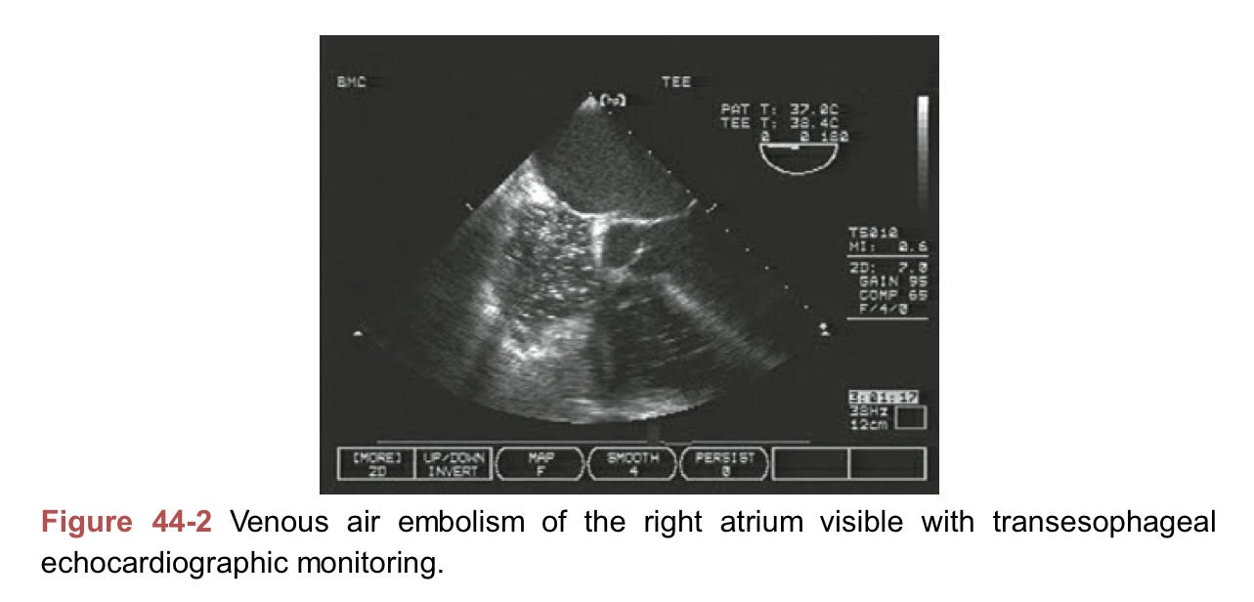

Slide 55
Intraoperative Complications
CO2 Extravasation
Venous Gas Embolism
Treatment
immediate terminated pneumoperitoneum
abdominal decompression
ACLS for cardiac arrest
Rapid IV fluid for initiate hypotension
Hyperventilation and give 100% O₂ →accelerated remove CO₂
Trendelenburg with Lt lateral decubitus position→minimize severity of Rt ventricular air lock

Slide 56
Intraoperative Complications
Patient Shifting and Falls
Ocular Injuries
Peripheral Nerve and Brachial Plexus Injuries
Airway Edema
Respiratory Dysfunction
Venous Thrombosis

Slide 57
Postoperative Nausea/Vomiting
Laparoscopic surgery greater risk of PONV than nonlaparoscopic surgery
LC highest reported
Laparoscopic bariatric: PONV is common cause of prolonged anesthesia recovery
Optimal antiemetic prophylaxis is key for minimizing prolong postanethesia recovery.

Slide 58
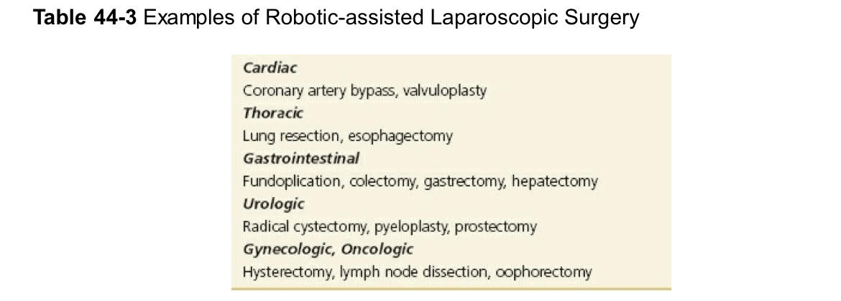
Robotic Laparoscopic Surgery
Highly sophisticated technology→requiring modification of both surgical and anesthetic management

Slide 59
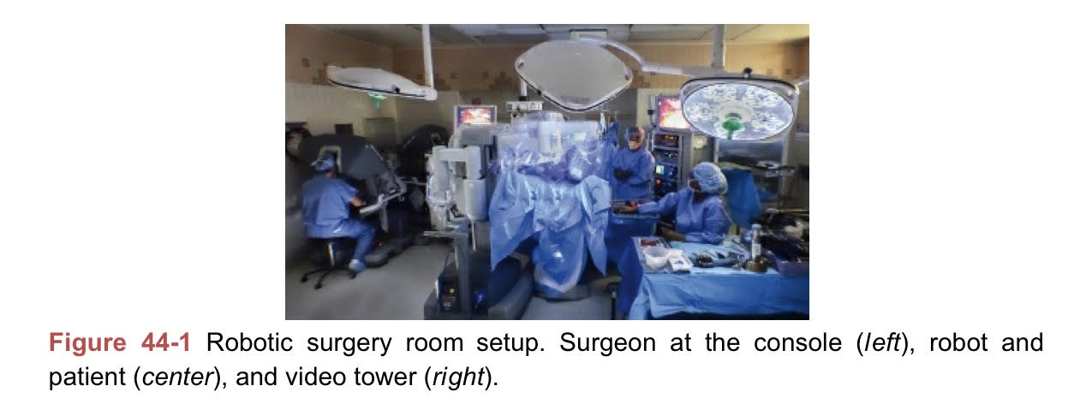

Slide 60
Take Home Messages
Laparoscopic surgery minimize surgical trauma
Shorter post op recovery
Advanced technology introduced robotic as common and growing feature
Pneumoperitoneum in conjunction with extreme patient positioning induce transient but significant multiorgan derangements require short-term manipulation of physiology to minimize complications

Slide 61
Take Home Messages
Serious complication related to surgery can occur any stage, constant vigilance and action are critical to avoiding permanent injury or death.
Preemptive multimodal analgesia and PONV prophylaxis stratigies in laparoscopy are keys to optimal postoperative recovery.

Slide 62
Reference
Barash clinical anesthesia eighth edition

Slide 63
Thank You

